Slide 1
Measuring Welfare
Copyright © 2019 Hal R. Varian

Slide 2
Class Organisation
Class Participation (5%)
Quizzes (5% x 2): Total 3 quizzes, top 2 will count. Optional but students encouraged to complete Open for 2 weeks after lecture except for last quiz, one attempt.
Bisemester Test 2 (35%): in Week 13, lecture time.
Office hours: please contact either Jonathan Yeo (me) or Xiaojie.

Slide 3
Introduction
One central theme in economics is the following: How should we distribute scarce resources?
Such decisions are social choices which affect many people. For example:
At a restaurant, how to split the food you have ordered?
Which bidders should we allocate limited COEs to?
How should government revenue be spent?
People may have slightly different opinions, but a common theme is that we want to make everyone as happy as possible (:
Notes:
Social choices because it concern not just the self, but others as well.

Slide 4
Introduction
In the coming lectures, we will be examining different perspectives behind social choices.
General Theme:
How can/should a (benevolent) social planner make decisions for groups of people?
Week 8: Common measures of individual and social welfare.
Week 9: Simple analyses of market interventions.
Week 10: Efficiency: just leave it to markets?
Week 11: Why is making the “best” social choice not so simple...?
Week 12: A (theoretical) argument for utilitarianism..
Quiz 4
Quiz 5
Quiz 6

Slide 5
Today’s lecture
One way to make such decisions is to choose the option which maximises peoples’ “welfare”. But!! What exactly is welfare, and how do we measure it? This lecture will provide an introductory explanation about such concerns.
Theoretical background of common measures of individual welfare for 1) Consumers*, 2) Producers.
This will serve as a background for measuring social welfare: the aggregate welfare of individual consumers and producers!
You will need to be familiar with the chapters related to analysing consumers decisions in HE1001.
Notes:
Our focus will mainly be on consumers.

Slide 6
Measuring Welfare in Monetary Terms

Slide 7
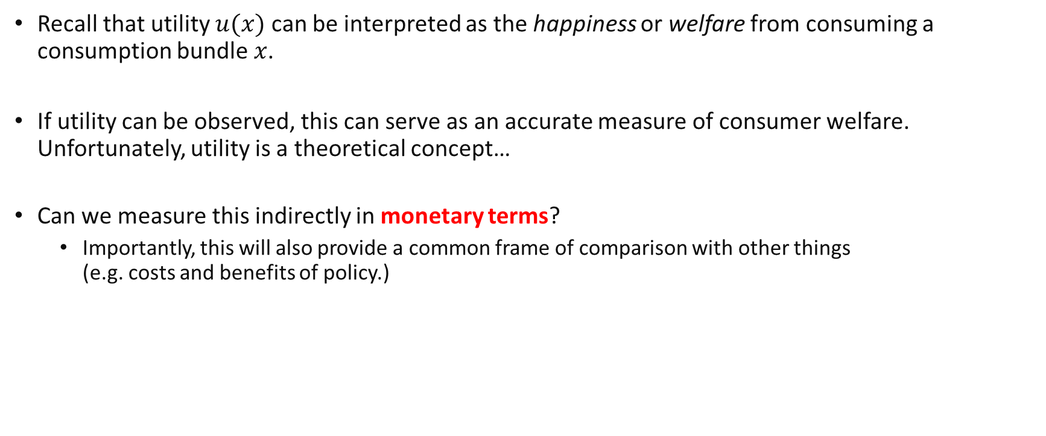
The monetary value of welfare
Recall that utility $u(x)$ can be interpreted as the happiness or welfare from consuming a consumption bundle $x$.
If utility can be observed, this can serve as an accurate measure of consumer welfare. Unfortunately, utility is a theoretical concept…
Can we measure this indirectly in monetary terms?
Importantly, this will also provide a common frame of comparison with other things (e.g. costs and benefits of policy.)

Slide 8
Reservation Prices
A concept which can captures this is the Reservation Price: The maximum amount of money one is willing to pay for “something”
General Idea: How much you are willing to pay should be commensurate with the happiness or welfare you are getting out of it.
Conceptually, the reservation price captures the tradeoff between utility from the “something” and utility from money.
It can be thought of as being related to the Marginal Rate of Substitution (MRS) between the two.
Notes:
Remember that the MRS measures at a particular consumption bundle, the rate at which a consumer is willing to trade one good for another so as to maintain the same utility.
When the other good is money, it sort of reflects an exchange rate between utility of a good and money.

Slide 9
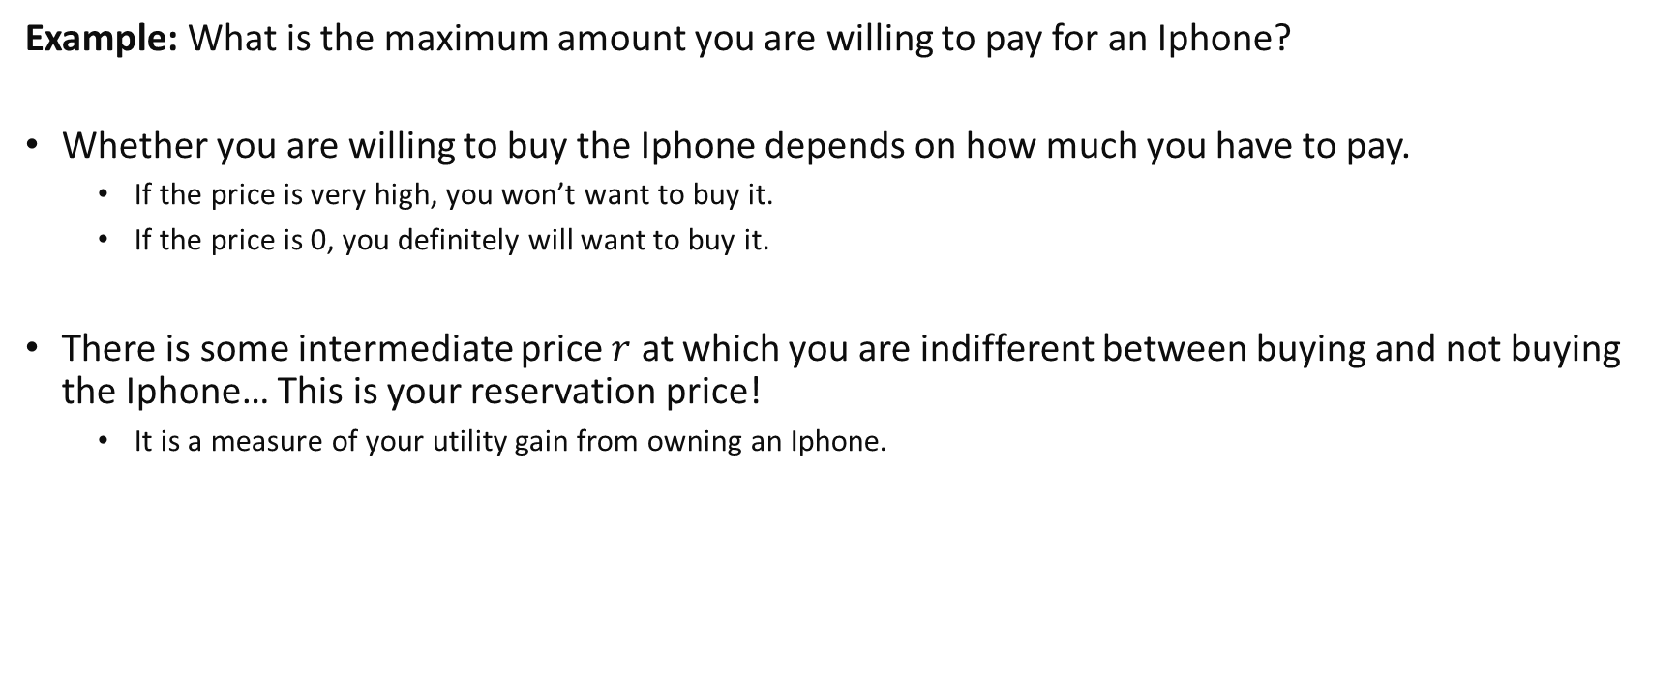
Reservation Prices
Example: What is the maximum amount you are willing to pay for an Iphone?
Whether you are willing to buy the Iphone depends on how much you have to pay.
If the price is very high, you won’t want to buy it.
If the price is 0, you definitely will want to buy it.
There is some intermediate price $r$ at which you are indifferent between buying and not buying the Iphone… This is your reservation price!
It is a measure of your utility gain from owning an Iphone.

Slide 10
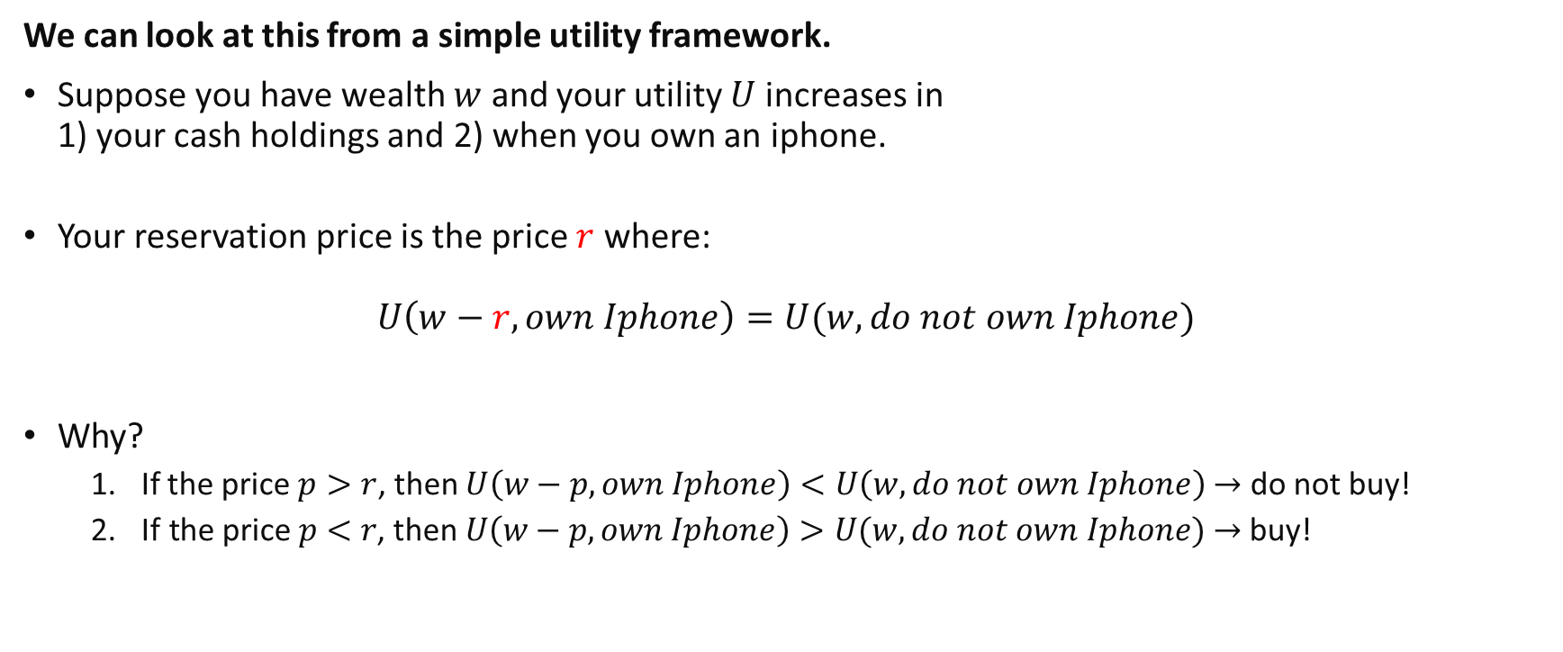
Reservation Prices
We can look at this from a simple utility framework.
Suppose you have wealth $w$ and your utility $U$ increases in 1) your cash holdings and 2) when you own an iphone.
Your reservation price is the price $r$ where:
$$U\left(w−r,own Iphone\right)=U(w,do not own Iphone)$$
Why?
If the price $p>r$, then $U\left(w−p,own Iphone\right)<U\left(w,do not own Iphone\right)$ $→$ do not buy!
$\text{If} \text{the} \text{price} p<r\text{, }\text{then} U\left(w−p,own Iphone\right)>U(w,do not own Iphone)$ $→$ buy!

Slide 11
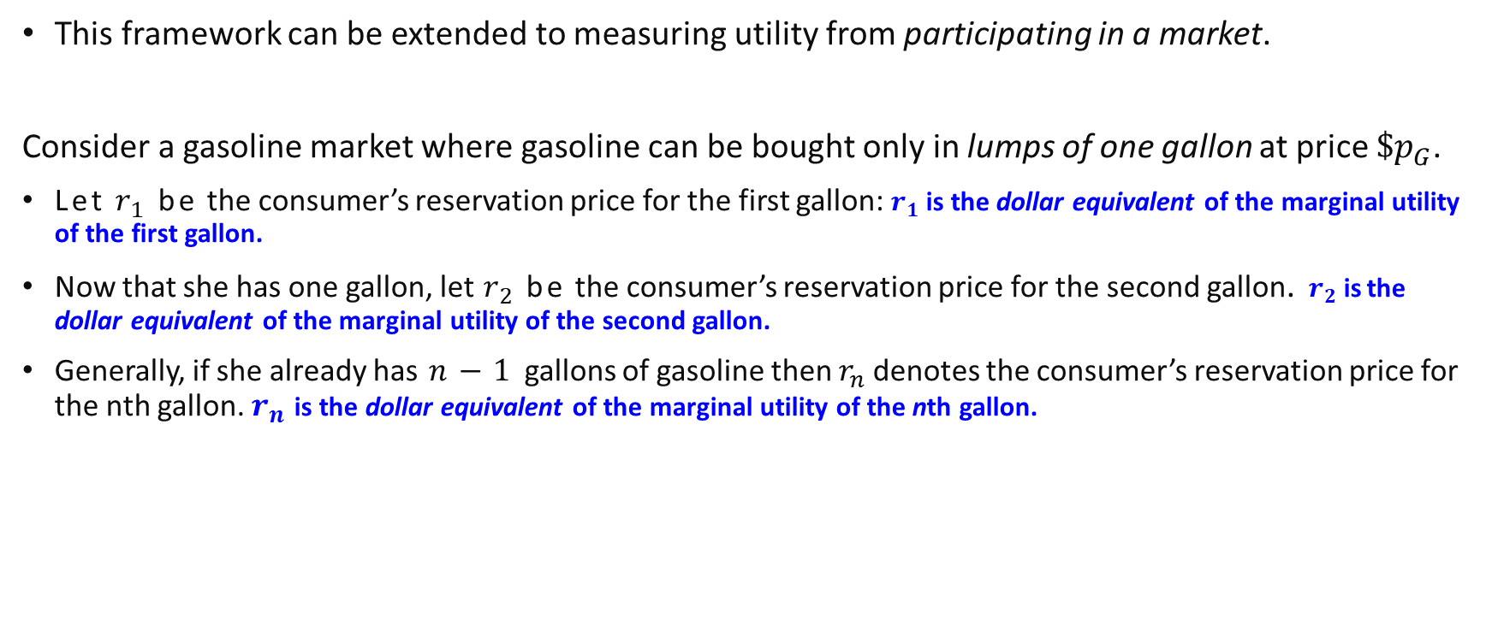
Gains to Trade
This framework can be extended to measuring utility from participating in a market.
Consider a gasoline market where gasoline can be bought only in lumps of one gallon at price $\$p_{G}$.
Let $r_{1}$ be the consumer’s reservation price for the first gallon: $r_{1}$is the dollar equivalent of the marginal utility of the first gallon.
Now that she has one gallon, let $r_{2}$ be the consumer’s reservation price for the second gallon.$r_{2}$is the dollar equivalent of the marginal utility of the second gallon.
Generally, if she already has $n−1$ gallons of gasoline then $r_{n}$ denotes the consumer’s reservation price for the nth gallon. $r_{n}$ is the dollar equivalent of the marginal utility of the nth gallon.
Notes:
While we consider only 1 good here, marginal utility generally considers also the negative effects of consumption of other goods when buying more of the main good (say if income is limited).

Slide 12
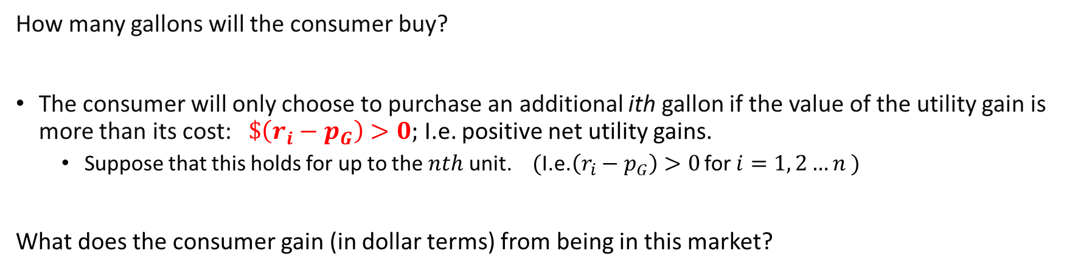

Gains to Trade
How many gallons will the consumer buy?
The consumer will only choose to purchase an additional ith gallon if the value of the utility gain is more than its cost: $\$\left(r_{i}−p_{G}\right)>0;$ I.e. positive net utility gains.
Suppose that this holds for up to the $nth$ unit. $($I.e.$\left(r_{i}−p_{G}\right)>0$ for $i=1, 2…n )$
What does the consumer gain (in dollar terms) from being in this market?
Gains to trade: dollar value of net utility gains.
$$\sum_{i=1}^{n}{\left(r_{i}−p_{G}\right)}=(\sum_{i=1}^{n}{r_{i})−{(np}_{G})}$$
Notes:
The left hand term is the dollar value of utility gains from consuming $n$ gallons while the right hand term is the dollar cost of consuming the $n$ gallons.

Slide 13
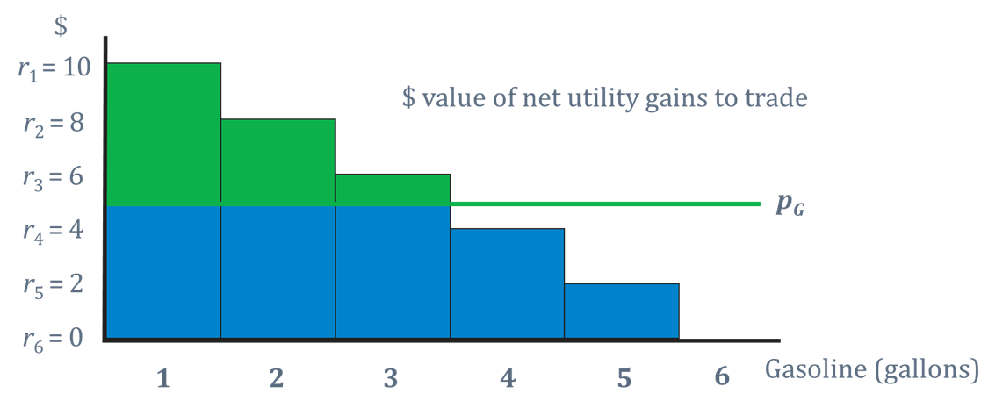

Gains to Trade
A plot of $r1, r2, . . . , rn,$. . . against n is a reservation price “curve”.
Dollar value of net utility gains (Gains to trade)

Slide 14
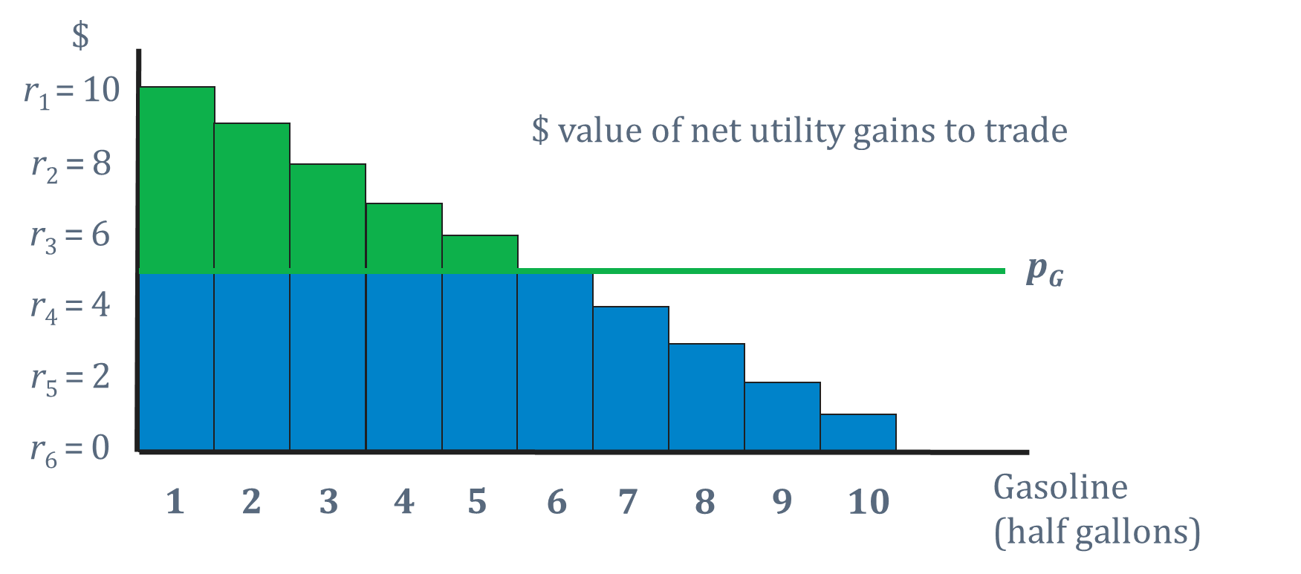
Gains to Trade
Suppose that gasoline can now be purchased in half gallons:
Dollar value of net utility gains (Gains to trade)

Slide 15
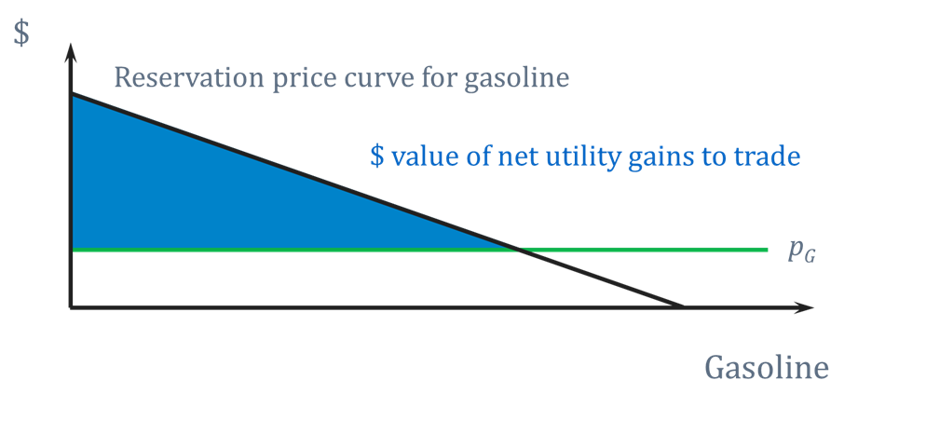
Gains to Trade
Suppose gasoline can be purchased in any quantity (infinitely divisible):
The monetary value of net utility gains to trade is just the area between the *reservation price curve* and the price line
Dollar value of net utility gains (Gains to trade)

Slide 16

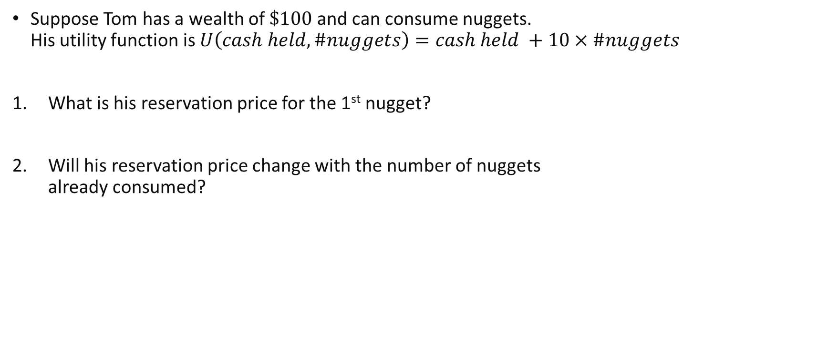
Review questions 1
Suppose Tom has a wealth of $\$100$and can consume nuggets. His utility function is $U\left(cash held, \#nuggets\right)=cash held +10×\#nuggets$
What is his reservation price for the 1st nugget?
Will his reservation price change with the number of nuggets already consumed?

Slide 17
Consumer Surplus

Slide 18
Gains to Trade vs Consumer Surplus
Notice that the previous figure closely resembles a figure for consumer surplus!
However, the inverse demand curve is NOT generally the same as the reservation price curve!
The area for consumer surplus is not necessarily equal to the area for equivalent utility gains!
*Inverse demand curve* for gasoline.
Consumer Surplus

Slide 19
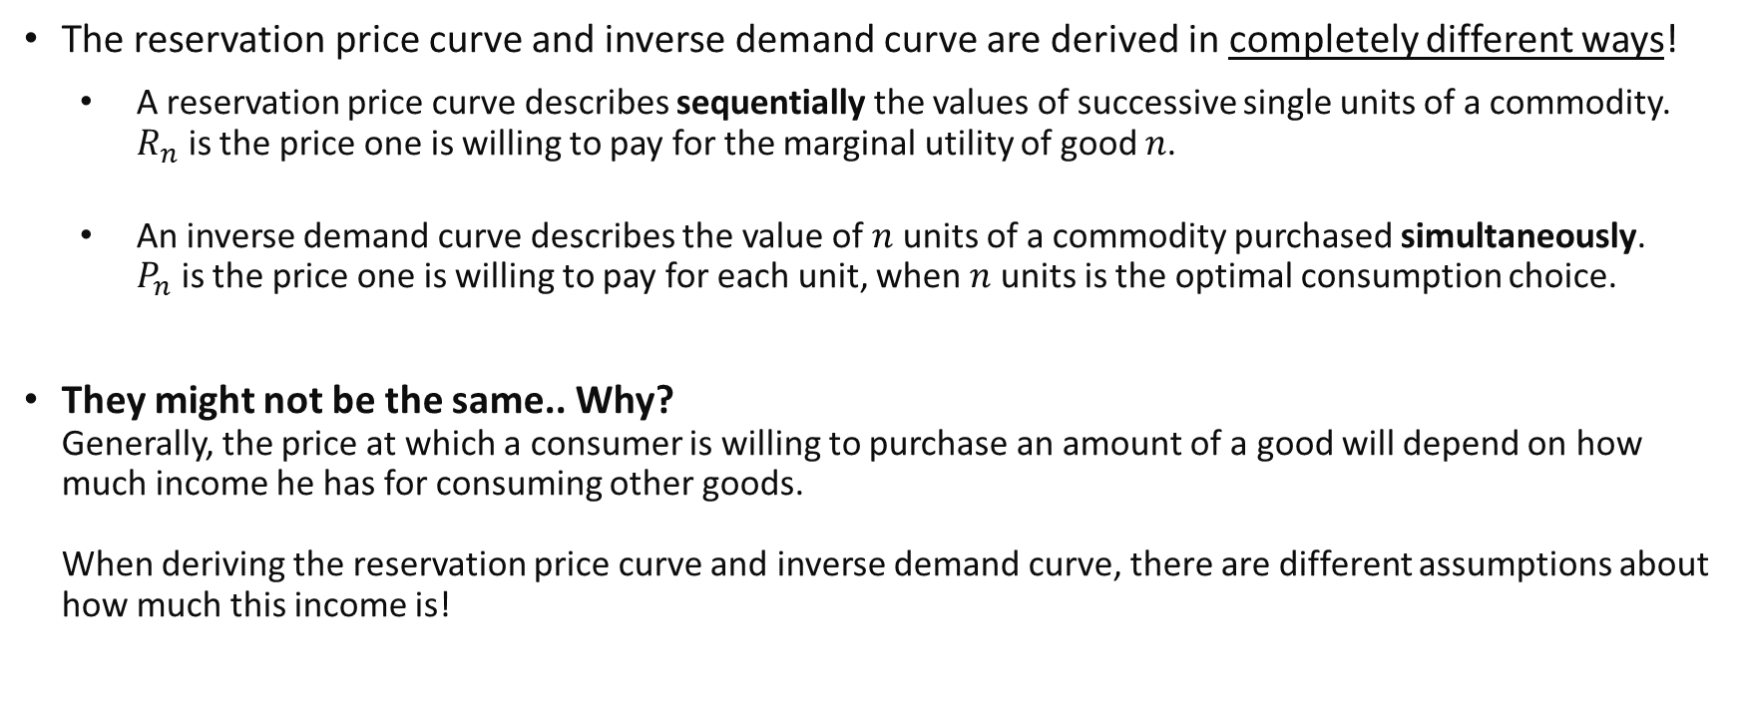
Reservation Price Curve vs Inverse Demand Curve
The reservation price curve and inverse demand curve are derived in completely different ways!
A reservation price curve describes sequentially the values of successive single units of a commodity. $R_{n}$ is the price one is willing to pay for the marginal utility of good $n$.
An inverse demand curve describes the value of$n$ units of a commodity purchased simultaneously. $P_{n}$ is the price one is willing to pay for each unit, when $n$ units is the optimal consumption choice.
They might not be the same.. Why? Generally, the price at which a consumer is willing to purchase an amount of a good will depend on how much income he has for consuming other goods. When deriving the reservation price curve and inverse demand curve, there are different assumptions about how much this income is!
Notes:
Reservation Price of unit n: if you already have/purchased n-1 units, how much are you willing to pay for the nth unit.
Inverse demand: If you are not currently purchasing anything, what is the price which will make you buy a total of n units.

Slide 20
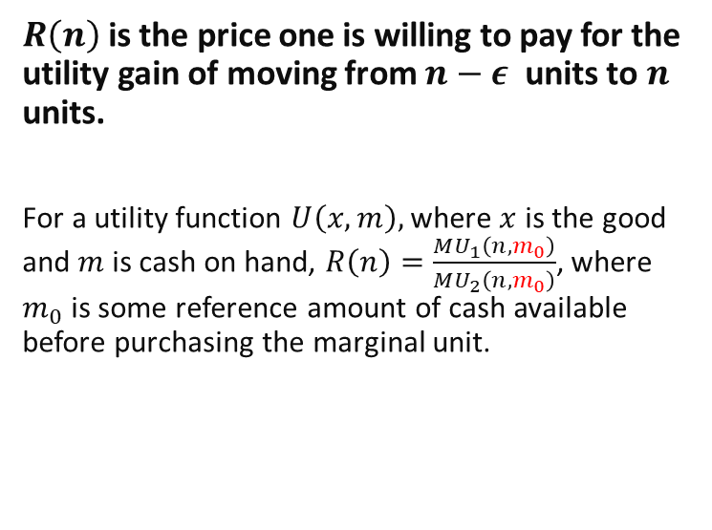
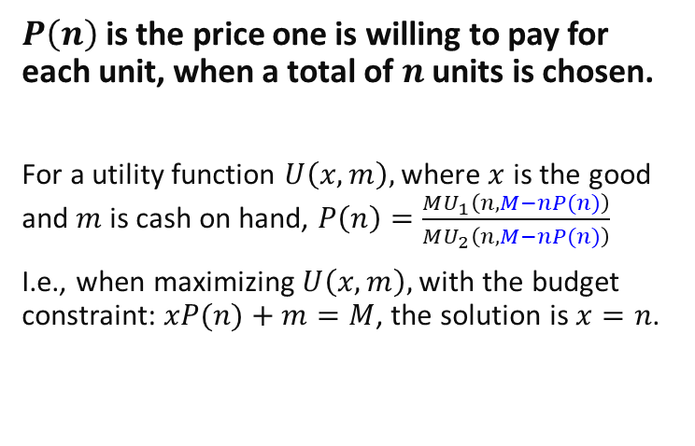
Reservation Price Curve vs Inverse Demand Curve
For the case of infinitely divisible goods (i.e. very small units $ε→0$).
$R\left(n\right)$ is the price one is willing to pay for the utility gain of moving from $n−ε$ units to $n$ units.
For a utility function $U\left(x,m\right),$ where $x$ is the good and $m$ is cash on hand, $R\left(n\right)=\frac{MU_{1}\left(n,m_{0}\right)}{MU_{2}\left(n,m_{0}\right)}$, where $m_{0}$ is some reference amount of cash available before purchasing the marginal unit.
$P\left(n\right)$ is the price one is willing to pay for each unit, when a total of $n$ units is chosen.
For a utility function $U\left(x,m\right),$ where $x$ is the good and $m$ is cash on hand, $P\left(n\right)=\frac{MU_{1}\left(n,M−nP(n)\right)}{MU_{2}\left(n,M−nP(n)\right)}$
I.e., when maximizing $U\left(x,m\right),$with the budget constraint: $xP(n)+m=M$, the solution is $x=n$.
$m_{0}$is not necessarily equal to $M−nP(n)$! In the latter, it is assumed that ALL $n$ units are purchased at price $P(n)$, this is not the case in the former!
Notes:
For the inverse demand curve, recall how we derived this through the utility maximisation problem.
For reservation price, here is the proof:
$u\left(x−ε,w−C\right)=u(x,w−C−εr_{x})$
$u\left(x−ε,w−C\right)−u(x,w−C)=u(x,w−C−εr_{x})−u\left(x,w−C\right)$
$\frac{\left[u\left(x−ε,w−C\right)−u\left(x,w−C\right)\right]}{ε}=\frac{\left[u\left(x,w−C−εr_{x}\right)−u\left(x,w−C\right)\right]}{ε}$
$MU_{1}\left(x,w−C\right)=r_{x}MU_{2}(x,w−C)$
$r_{x}=\frac{MU_{1}\left(x,w−C\right)}{MU_{2}\left(x,w−C\right)}$

Slide 21
Approximating the value of gains to trade.
We would very much like to get the gains to trade from the reservation price curve!
Unfortunately, estimating a consumer’s reservation price curve can be difficult…
As an approximation, the reservation price curve is replaced with the consumer’s inverse demand curve.
Somewhat reasonable as both are related to the Marginal Rate of Substitution of the good with money.
Approximating the reservation-price curve with the inverse demand curve gives us Consumer Surplus which is an estimate of the gains to trade..

Slide 22
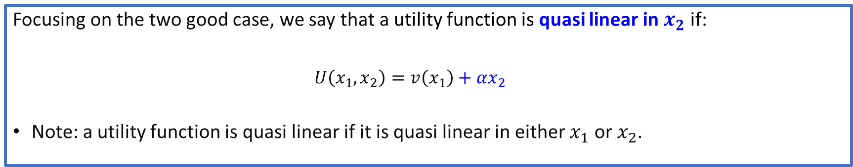
Quasi Linear utility
Is there any case where consumer surplus gives an exact measure of gains to trade?
Special case: when utility is quasi linear in money holdings (or equivalently other goods).
This is because there are then no income effects!
Focusing on the two good case, we say that a utility function is quasi linear in $x_{2}$ if:
$$U\left(x_{1},x_{2}\right)=v\left(x_{1}\right)+{αx}_{2}$$
Note: a utility function is quasi linear if it is quasi linear in either $x_{1}$ or $x_{2}$.
Notes:
Recall that earlier, we mentioned that income effects are what lead to the difference between the reservation price curve and the inverse demand curve.
Note: if utility is quasi linear in another good x2 with fixed price, it is also as if it is quasi linear in money.
Why? Because if the budget is p1x1+p2x2=W, we can treat p2x2 like the money holdings for other goods. Let M=p2x2, then u(x1)+ax2= u(x1)+(a/p2)M which is quasi linear in money holdings.

Slide 23





Quasi Linear utility
$U\left(x_{1},x_{2}\right)=v\left(x_{1}\right)+{αx}_{2}$
$$x_{2}$$
When utility is quasi linear in $x_{2}$, indifference curves are just vertical “parallel” shifts.
There is no income effect on consumption of good 1. (Parallel shifts in the budget line do not affect consumption of good 1).
MRS at any point ($x_{1},x_{2})$ with the same $x_{1}$ is constant.
$$x_{1}$$
$$X_{1}$$
Notes:
Try deriving these indifference curves.

Slide 24

Review questions 2
Which of these utilities are quasi-linear? (Select all)
$U\left(x,y\right)=\sqrt{x}+\sqrt{y}$
$U\left(x,y\right)=\sqrt{x}+4y$
$U\left(x,y\right)=x+3\sqrt{y}$
Suppose $U\left(x,y\right)=\sqrt{y}+3x$. For which good is there zero income effect?
Good $x$
Good $y$
Good $x$ and Good $y$
Neither.

Slide 25
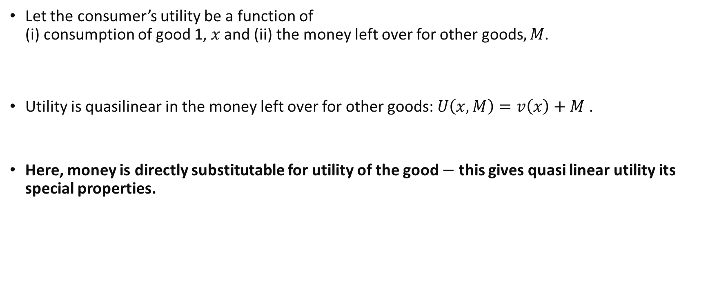
Quasi Linear utility and Consumer Surplus
Let the consumer’s utility be a function of (i) consumption of good 1, $x$ and (ii) the money left over for other goods$, M$.
Utility is quasilinear in the money left over for other goods: $U\left(x,M\right)=v\left(x\right)+M$ .
Here, money is directly substitutable for utility of the good $−$ this gives quasi linear utility its special properties.
Notes:
Can split utility into that from good x and that from good y.
Suppose utility is non quasi-linear, u(x,M)=xM
Not clear mathematically what is the distribution attributable to each input.

Slide 26
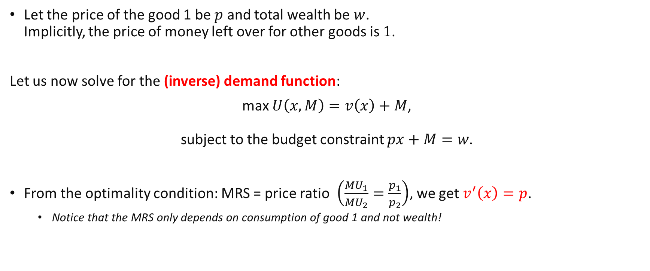
Quasi Linear utility and Consumer Surplus
Let the price of the good 1 be $p$ and total wealth be $w$. Implicitly, the price of money left over for other goods is $1$.
Let us now solve for the (inverse) demand function:
max $U\left(x,M\right)=v\left(x\right)+M$, subject to the budget constraint $px+M=w$.
From the optimality condition: MRS = price ratio $\left(\frac{MU_{1}}{MU_{2}}=\frac{p_{1}}{p_{2}}\right)$, we get $v^{′}\left(x\right)=p$.
Notice that the MRS only depends on consumption of good 1 and not wealth!

Slide 27







Quasi Linear utility and Consumer Surplus
From the earlier formula, $r\left(x\right)=\frac{MU_{1}\left(x,m\right)}{MU_{2}(x,m)}=$ $v′(x)$. This is exactly the same as inverse demand because $m$ here does not matter!
Implicitly, utility and money are interchangeable 1 to 1 for this $U$ and prices.
$$p$$
$$CS=\int_{0}^{x_{1}}{v′(x)}dx−p_{1}x_{1}$$
$$=v\left(x_{1}\right)−v\left(0\right)−p_{1}x_{1}$$
$$=gains to trade$$
$$p=u^{′}\left(x\right) \\ [Inverse demand≡ \\ reservation price]$$
CS
$$p′$$
When utility is quasi linear in money holdings, consumer surplus gives an exact measure of the net utility gain!
$$x$$
$$x_{1}$$

Slide 28
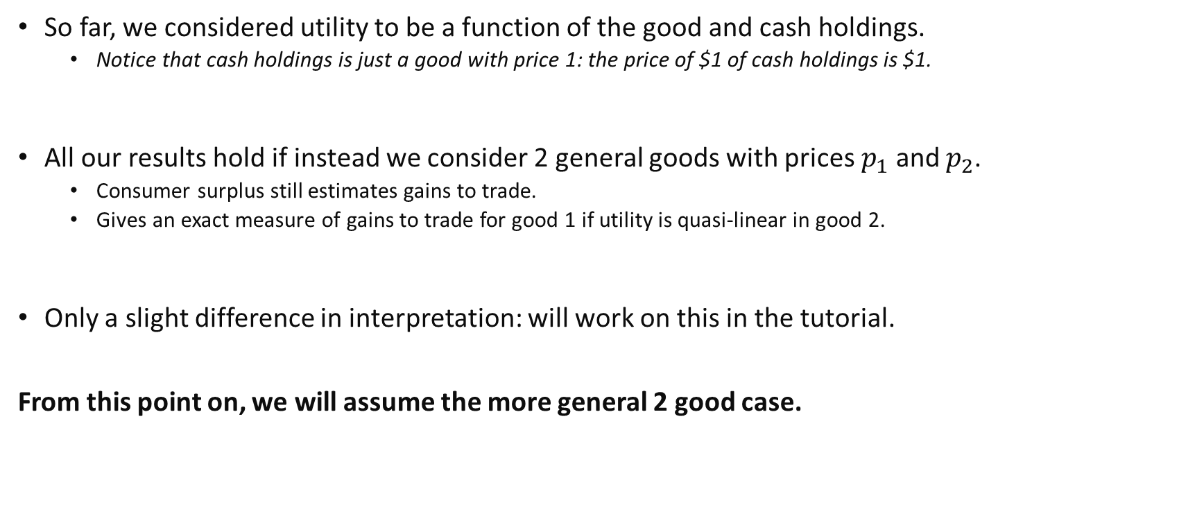
The more general 2 good case
So far, we considered utility to be a function of the good and cash holdings.
Notice that cash holdings is just a good with price 1: the price of $1 of cash holdings is $1.
All our results hold if instead we consider 2 general goods with prices $p_{1}$ and $p_{2}$.
Consumer surplus still estimates gains to trade.
Gives an exact measure of gains to trade for good 1 if utility is quasi-linear in good 2.
Only a slight difference in interpretation: will work on this in the tutorial.
From this point on, we will assume the more general 2 good case.
Notes:
$q_{1}\left(p_{1}^{′}−p_{1}^{′′}\right)$ is the how much less money you have to pay for the initial bundle.

Slide 29
Price Changes and Welfare

Slide 30
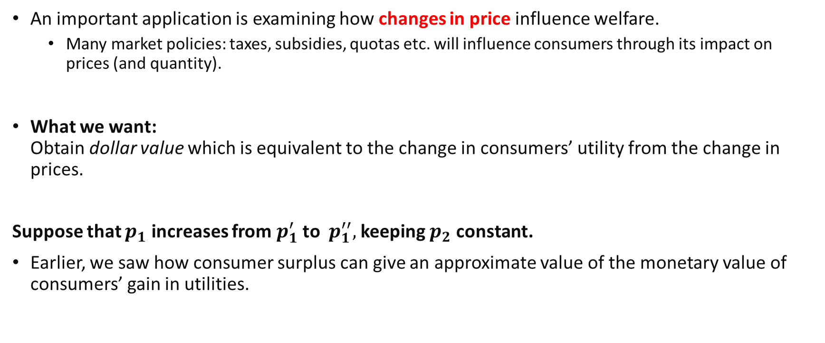
Price changes and Welfare
An important application is examining how changes in price influence welfare.
Many market policies: taxes, subsidies, quotas etc. will influence consumers through its impact on prices (and quantity).
What we want: Obtain dollar value which is equivalent to the change in consumers’ utility from the change in prices.
Suppose that $p_{1}$ increases from $p_{1}^{′}$to $p_{1}^{′′},$ keeping $p_{2}$ constant.
Earlier, we saw how consumer surplus can give an approximate value of the monetary value of consumers’ gain in utilities.

Slide 31
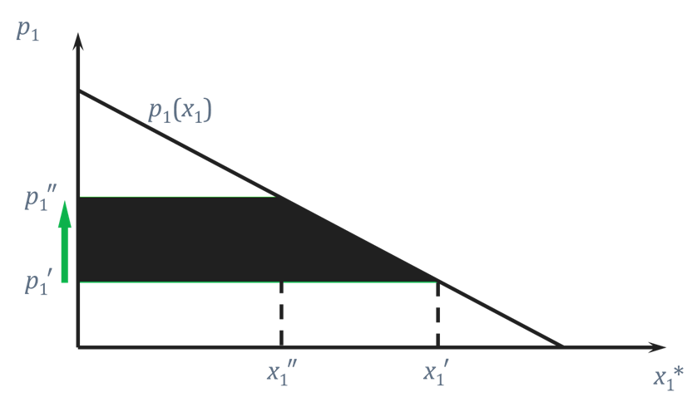

$Δ$ Consumer Surplus from a price change
The change in a consumer’s total utility is approximately the change in consumer surplus
This is exact when utility is quasi linear in the other good (e.g. money holdings).
CS after
Lost CS
Price changes and changes in Consumer Surplus

Slide 32
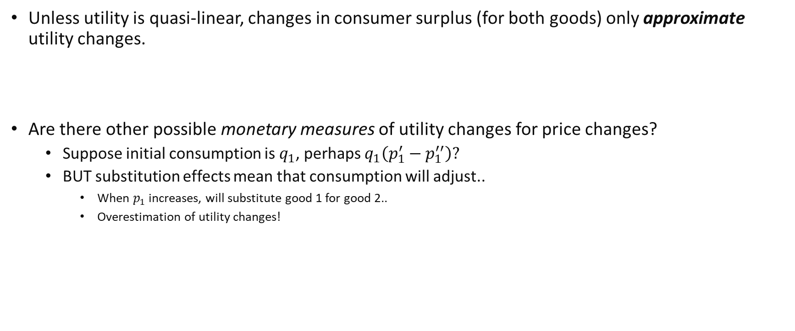
Other monetary measures of utility changes?
Unless utility is quasi-linear, changes in consumer surplus (for both goods) only approximate utility changes.
Are there other possible monetary measures of utility changes for price changes?
Suppose initial consumption is $q_{1}$, perhaps $q_{1}\left(p_{1}^{′}−p_{1}^{′′}\right)?$
BUT substitution effects mean that consumption will adjust..
When $p_{1}$ increases, will substitute good 1 for good 2..
Overestimation of utility changes!
Notes:
$q_{1}\left(p_{1}^{′}−p_{1}^{′′}\right)$ is the how much less money you have to pay for the initial bundle.

Slide 33
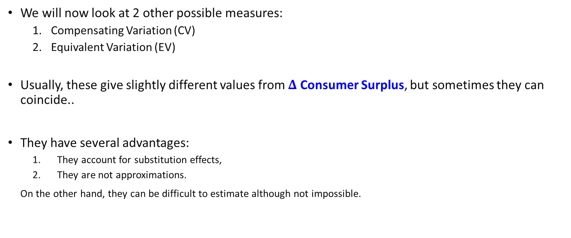
Compensating Variation & Equivalent Variation
We will now look at 2 other possible measures:
Compensating Variation (CV)
Equivalent Variation (EV)
Usually, these give slightly different values from $Δ$ Consumer Surplus, but sometimes they can coincide..
They have several advantages:
They account for substitution effects,
They are not approximations.
On the other hand, they can be difficult to estimate although not impossible.

Slide 34

Compensating Variation & Equivalent Variation
CV and EV are defined based on something called indirect utility. Indirect utility, $V(p,w)$, is the maximum utility a consumer can get at prices $p$ and wealth $w$.
$max U\left(x\right) s.t px=w →$ Get demand $x(p,w)$ $→$ Substitute demand into $U(x)$
At the fixed wealth $w$, The original utility level before the price increase is $V\left(p_{1}^{′},w\right).$ The final utility level after the price increase is $V(p_{1}^{′′},w)$.
(Note: for simplicity, we omit $p_{2}$ as a parameter as it is assumed to be constant.)
Notes:
Remember that in the standard utility maximisation problem, we have 2 parameters in the problem: prices and wealth/income.
Hence, the solution (demand) to it will always be a function of these parameters.

Slide 35

Compensating Variation & Equivalent Variation
Compensating variation:
At the new prices $p_{1}^{′′}$, what is the least income to be added which just restores the consumer’s original utility level? I.e. $V\left(p_{1}^{′′},w+CV\right)=V\left(p_{1}^{′},w\right)$.
Equivalent variation:
At the original prices $p_{1}′$, what is the maximum income to be removed which just gives the consumer the same final utility level? I.e. $V\left(p_{1}^{′′},w\right)=V\left(p_{1}^{′},w−EV\right)$.
The difference between the two are their “frames of reference”: whether we consider original consumption or final consumption as the “baseline”.
Notes:
Remember that for reservation prices, its value depends on the assumption of the frame of reference? (Slide 20)
Note that in both cases, we are trying to attain the minimum (efficient) level of income which will give us the original/final utility level.
For compensating variation, $(w+CV)$ is the minimum income which at new prices $p_{1}^{′′}$gives the consumer his/her original utility: $V\left(p_{1}^{′},w\right)$.
For equivalent variation, $(w−EV)$ is the minimum income which at original prices $p_{1}′$ gives the consumer his/her final utility $V\left(p_{1}^{′′},w\right).$

Slide 36
Review questions 3
Given the definition in the previous slides, what will be the sign of EV and CV for a price increase?
Positive
Negative
EV is always equal to CV
True
False

Slide 37
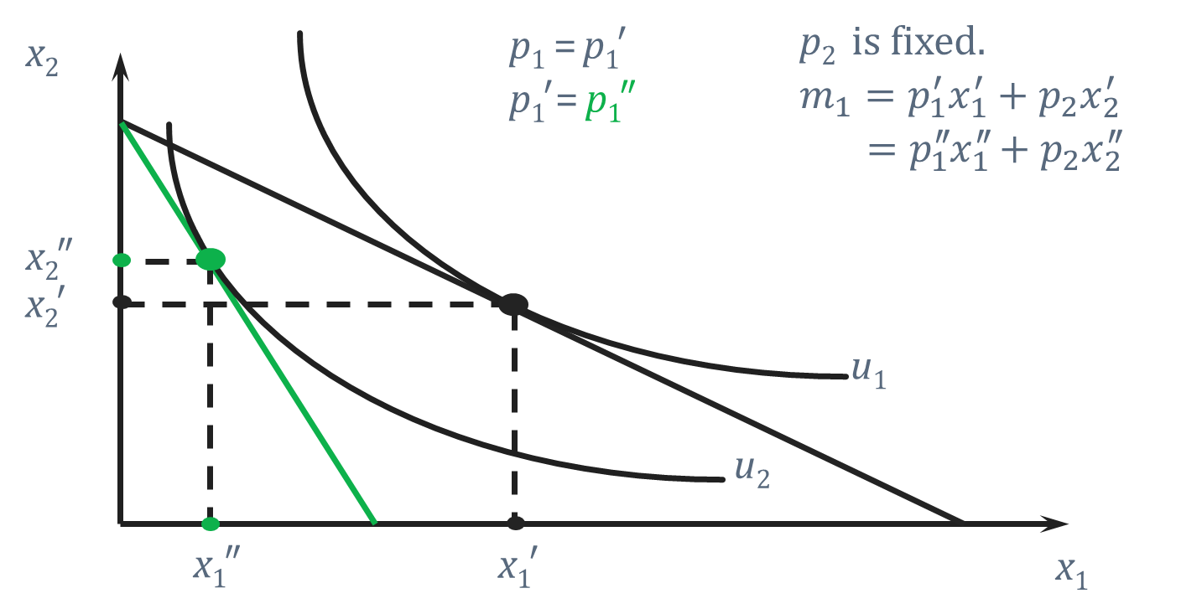

Compensating Variation
$$p_{1}^{′′}>p_{1}′$$
What happens if after the price change, we add some income --- Budget line shifts outward!
We want to give just enough income such that at the new prices, the consumer gets the same initial utility.

Slide 38
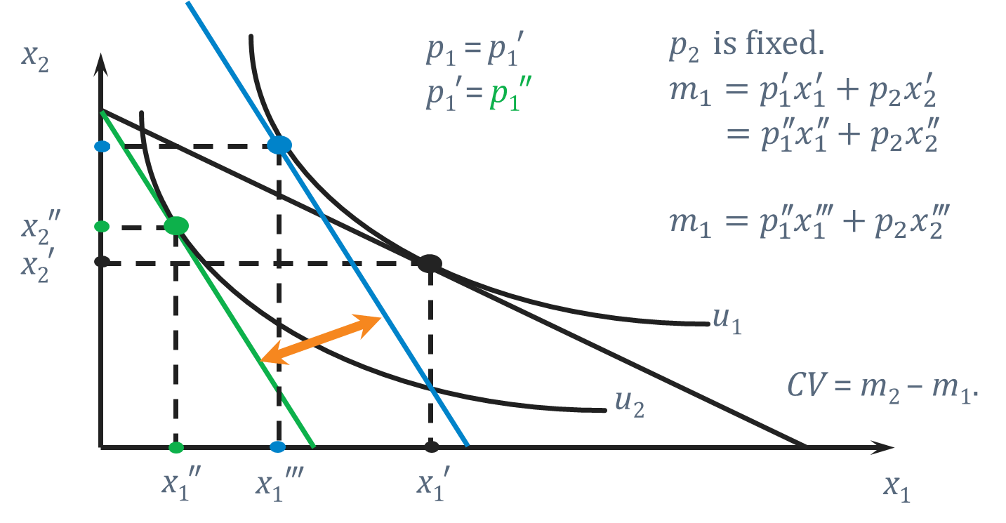

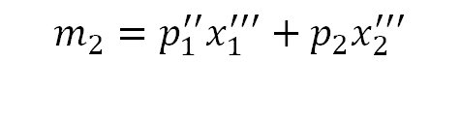
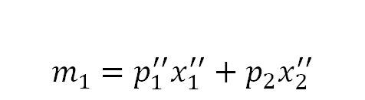


Compensating Variation
$$p_{1}^{′′}>p_{1}′$$
$$m_{1}=p_{1}^{′′}x_{1}^{′′}+p_{2}x_{2}^{′′}$$
$$x_{2}′′′$$
$$m_{2}=p_{1}^{′′}x_{1}^{′′′}+p_{2}x_{2}^{′′′}$$
$$CV=m_{2}−m_{1}$$

Slide 39

Equivalent Variation
$$p_{1}^{′′}>p_{1}′$$
What happens if before the price change, we remove some income --- budget line shifts inward!
We want to remove just enough income such that at the old prices, the consumer gets the same final utility.

Slide 40
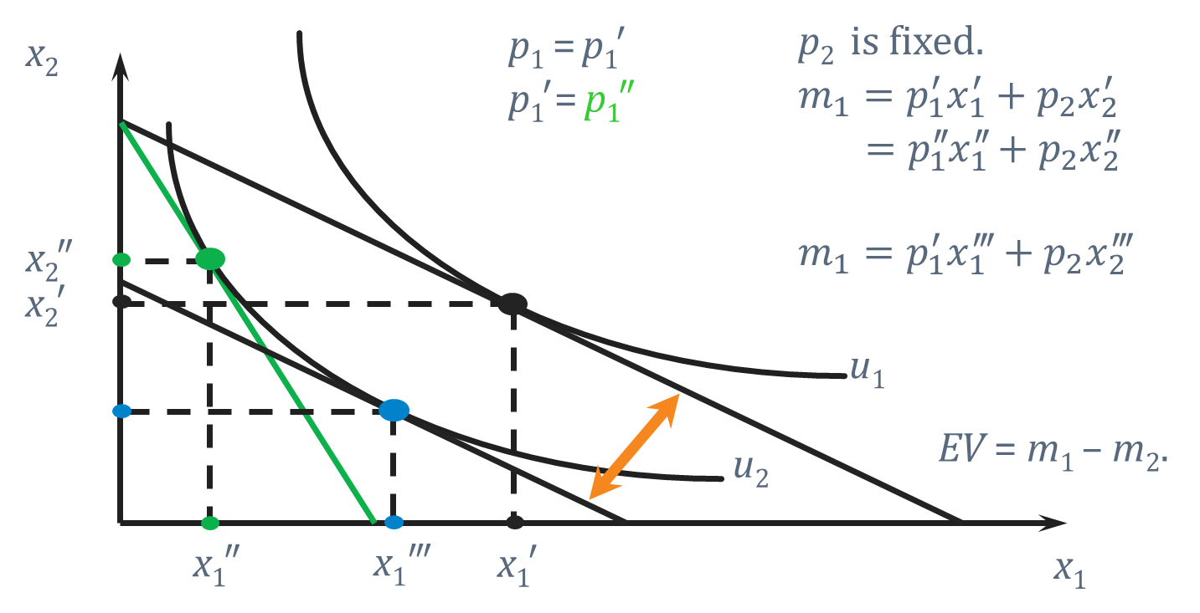

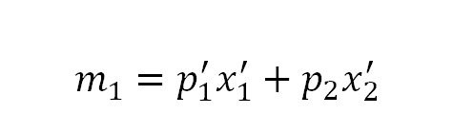
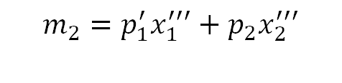

Equivalent Variation
$$p_{1}^{′′}>p_{1}′$$
$$m_{1}=p_{1}^{′}x_{1}^{′}+p_{2}x_{2}^{′}$$
$$m_{2}=p_{1}^{′}x_{1}^{′′′}+p_{2}x_{2}^{′′′}$$
$$x_{2}′′′$$
$$EV=m_{1}−m_{2}$$

Slide 41
Comparing the 3 measures..

Slide 42
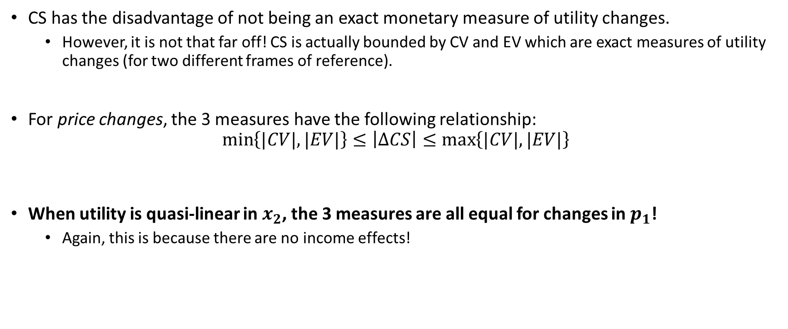
CV, EV and CS
CS has the disadvantage of not being an exact monetary measure of utility changes.
However, it is not that far off! CS is actually bounded by CV and EV which are exact measures of utility changes (for two different frames of reference).
For price changes, the 3 measures have the following relationship:
$$\min\left\{|CV|,|EV|\right\}≤\left|ΔCS\right|≤\max\left\{|CV|,|EV|\right\}$$
When utility is quasi-linear in $x_{2}$, the 3 measures are all equal for changes in $p_{1}$!
Again, this is because there are no income effects!
Notes:
Note that CV and EV are actually derived from a different demand concept compared to CS.
CS is the area under an inverse demand curve. (derived from a utility maximisation problem)
CV and EV are areas under an inverse compensated/hicksian demand curve (derived from a cost minimisation problem).
-> remember the earlier lecture on the different substitution effects?
For price increases, $\min\left\{CV,EV\right\}≤\left|ΔCS\right|≤\max\left\{CV,EV\right\}$ For price decreases, we have $\min\left\{|CV|,|EV|\right\}≤ΔCS≤\max\left\{|CV|,|EV|\right\}$

Slide 43
Producer Surplus

Slide 44
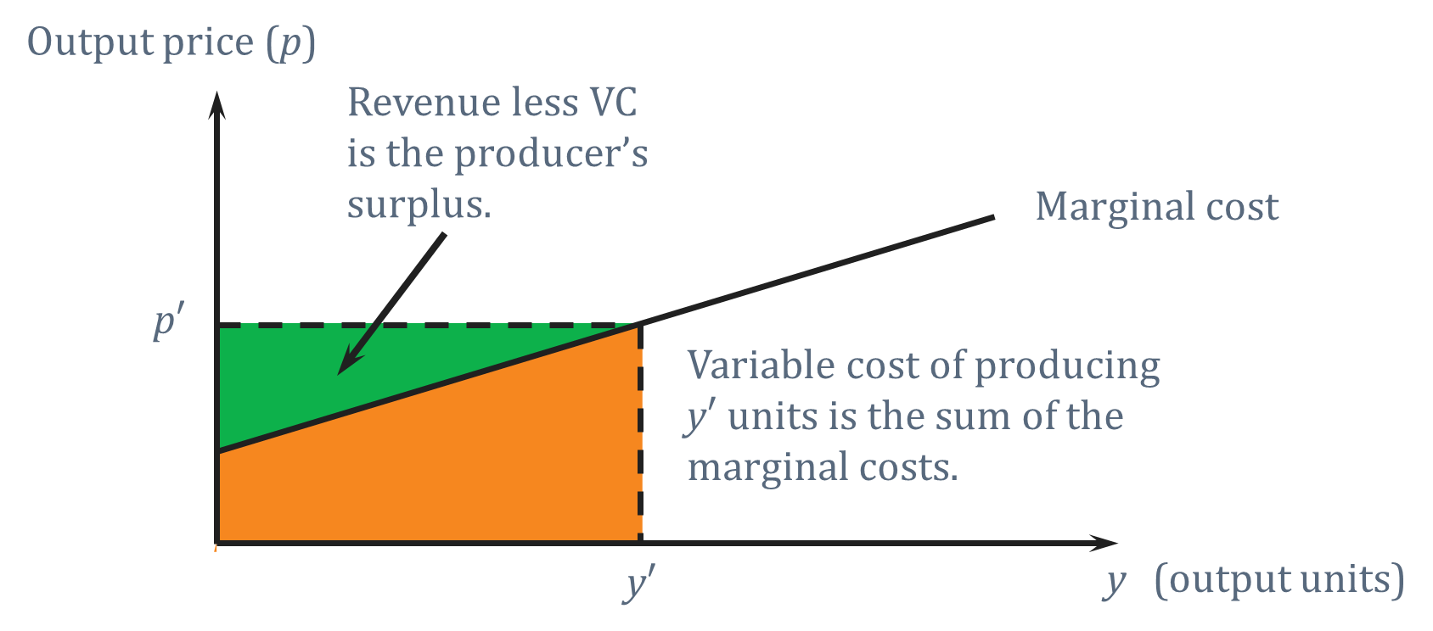

Producer Surplus
Likewise, firm’s welfare can be measured in dollars through producer surplus.
If firms care about only maximizing money returns, no need for any additional assumptions..
MC=$S(p)$
Notes:
If there are not fixed costs, then producer surplus is exactly equal to profits.

Slide 45
Key Learning Outcomes
Why do we need measures like Reservation Prices or Consumer Surplus?
When considering the welfare effects of price changes, what are the advantages and disadvantages of using measures like Equivalent Variation and Compensating Variation?
How exactly are these measures defined and what are the differences between them?
What is quasi-linear utility and what are its consequences for the above measures?

Slide 46

Readings
Varian Chapter 14.
Varian Chapter 6, Section 6.6. (optional) $−$ a discussion on reservation prices.
Varian Chapter 8. (revision) $−$ Income, Substitution Effects and a discussion on Hicksian/Compensated demand.

